Slide 1


?
Kevin xia
Yuetian Chen
Jeff li
Notes:
Presenter: Stephen / Yuetian Chen

Slide 2
Draw and Guess - Real Time ver.
1. Highly stylized real-time paint-and-quiz game
Pixel style multiplayer
100% Java implemented
2. Multi-threaded TCP server based multiplayer link pipeline
Time synchronization
Real-time chat room
Abnormal drop handling
3. Scalable string parsing utility
Transport protocol based on Base64 encrypted transmission
CSV-based vocabulary dictionary customization
4. Consistent and modern user interface layout and logic
Low performance overhead drawing board experience
Various customization
Notes:
Presenter: Stephen / Yuetian Chen

Slide 3

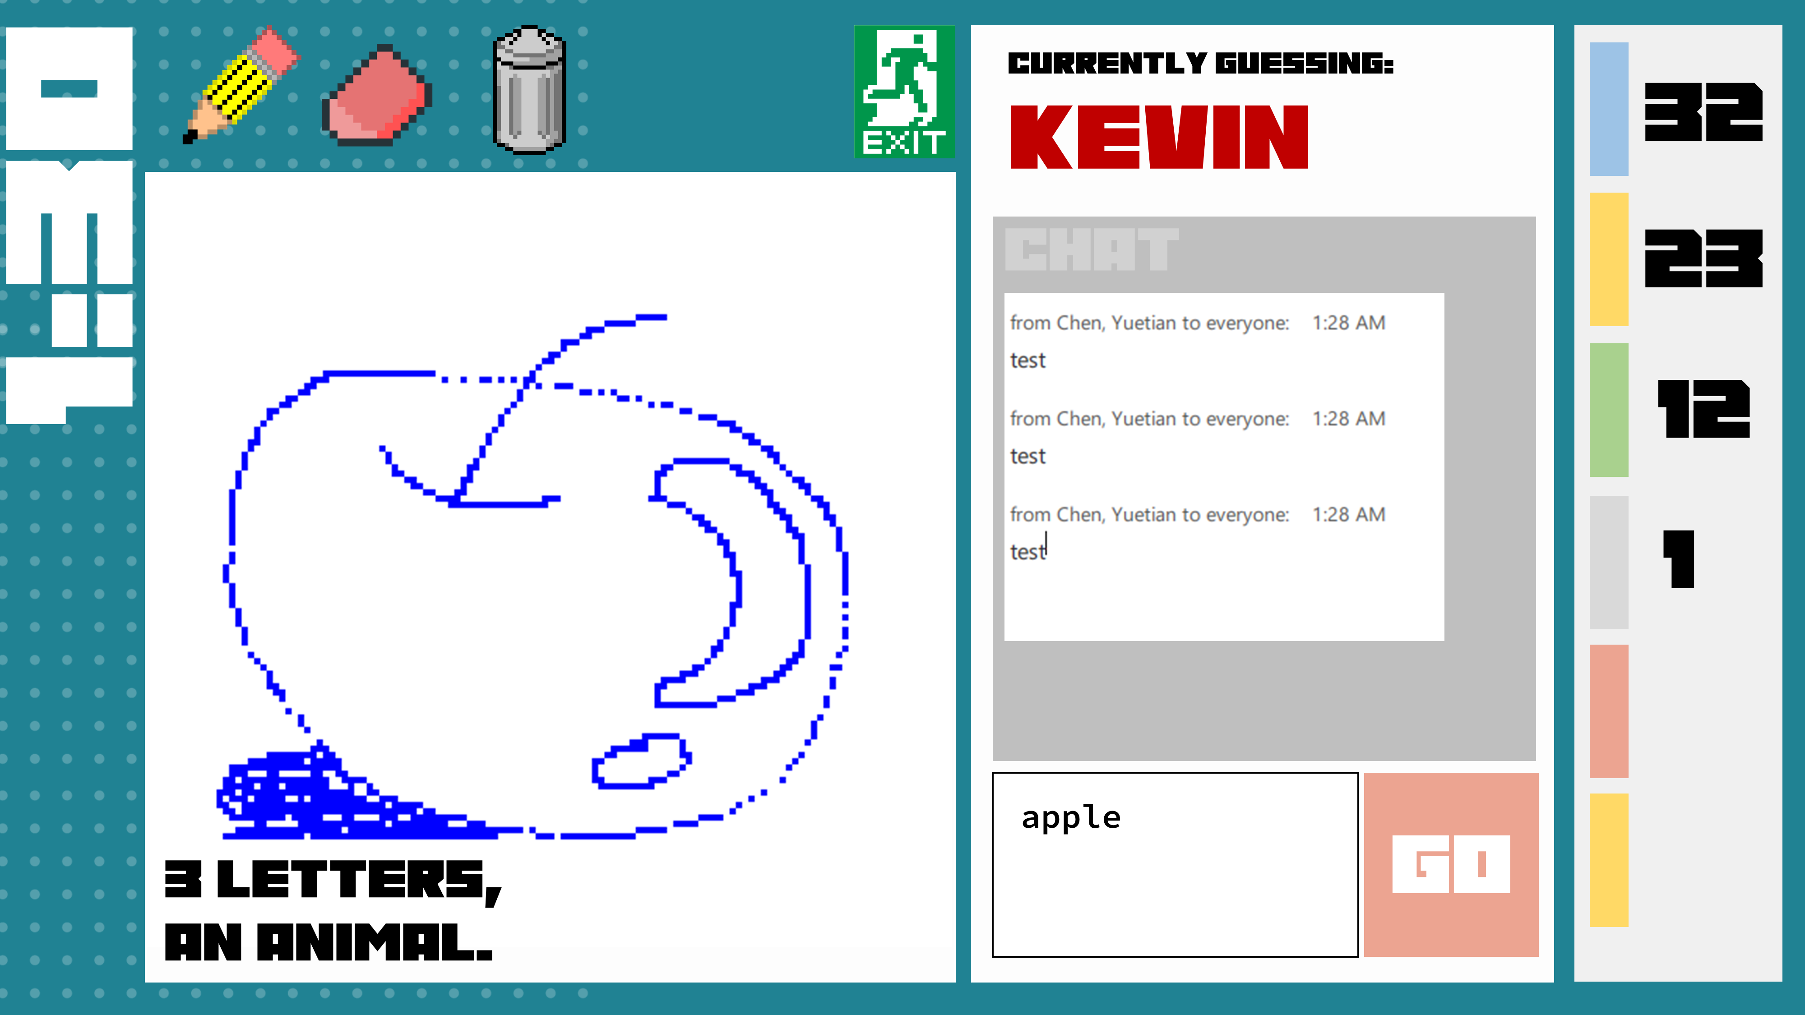

Highly stylized real-time paint-and-quiz game
Pixel style multiplayer & 100% Java implemented
Pixelated guessing game
2-8 players
Real-time guessing by each other's drawings for a limited time
Unlimited puzzles, quit at any time
All content is implemented in Java
GUI: Java swing
Compatibility: Java 11+
Notes:
Presenter: Stephen / Yuetian Chen

Slide 4


Multi-threaded TCP server based multiplayer link pipeline
Time synchronization
Every player can synchronize time with the server side
Server-Centric Time Synchronization
Send time updates per tick server
GUI draws current state in real time
Supports breakpoint reconnection
1:30
SYNC
Notes:
Presenter: Kevin

Slide 5
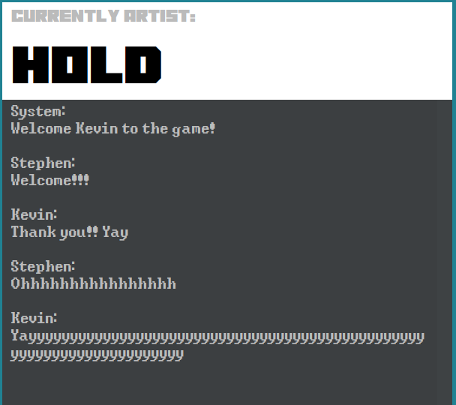
Multi-threaded TCP server based multiplayer link pipeline
Real-time chat room
Live chat room
Everyone's messages will be synchronized in real time
For collecting answers to player guesses
The system will intervene in the following scenarios
Room creation
User enters
User leaves
Current score
Current Winners
End of rounds
Notes:
Presenter: Kevin

Slide 6
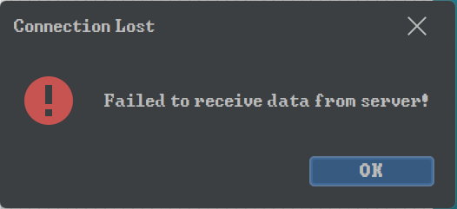
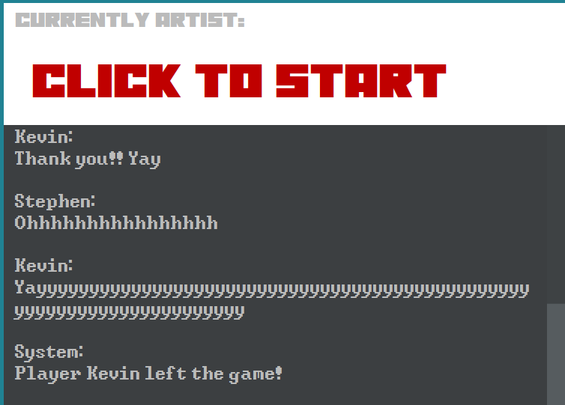
Multi-threaded TCP server based multiplayer link pipeline
Abnormal drop handling
When the server leaves the game
Each client receives an alert
The game is over
Return to main menu
When the player leaves the game
Each client receives a notification
The game continues
The system outputs the leaving message in Chat
…
Notes:
Presenter: Kevin

Slide 7
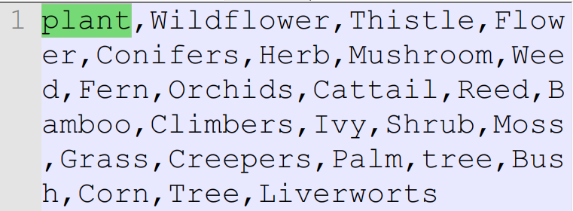
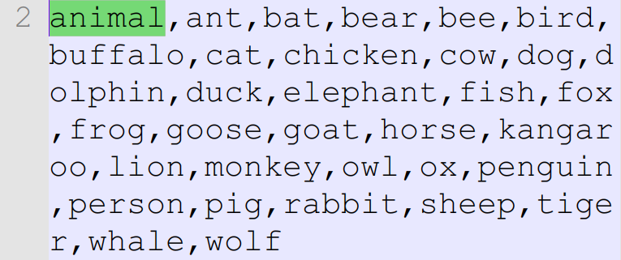
Scalable string parsing utility
CSV-based vocabulary dictionary customization
Reads a.csv file
.csv format Category , words ,words, …
Read the data in to a LinkedList
Use random.nextInt()% remaining word size to get the secret word’s index
Every time we got the new secret word,
remove it from the remaining words
Notes:
Presenter: Jeff

Slide 8
Scalable string parsing utility
CSV-based vocabulary dictionary customization
Use Hash mark as the separator,
Data pack format CATEGORY#ACTION#arg1#arg2#...
MessagePack:
DATA#MESSAGE#message
EVENT#JOIN##id#name
To encrypt data
Such as message, username, IP…
Unicode, but the \ and #
So chose Base64. which is already being implemented by java.
Base64.getDecoder()
Base64.getEncoder()
Notes:
Presenter: Jeff

Slide 9
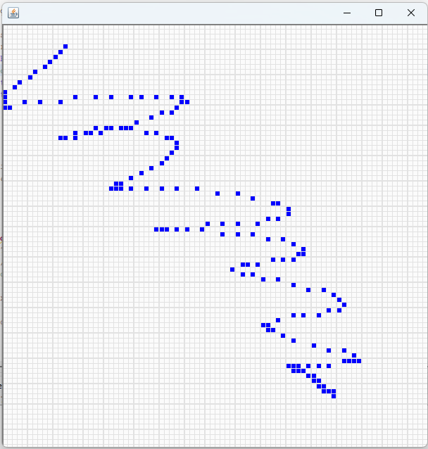
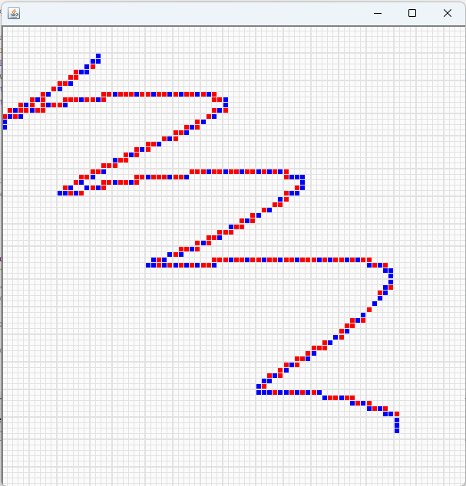
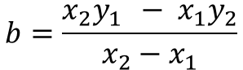
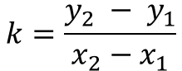
Consistent and modern user interface layout & logic
Low performance overhead drawing board experience
Checkerboard based on Java Swing PaintComponent implementation
80x80 rectangular matrix
Listening by MouseMotionListener()
When mouseDragged receives a command
Get the mouse position
Remap the corresponding block
Fill color
Frequency not controlled by the developer
Two-point line segment filling algorithm based on Euclidean distance
$$k=\frac{y_{2} − y_{1}}{x_{2}−x_{1}}$$
$$b=\frac{{x_{2}y}_{1 } − x_{1}y_{2}}{x_{2}−x_{1}}$$
Notes:
Presenter: Stephen / Yuetian Chen

Slide 10

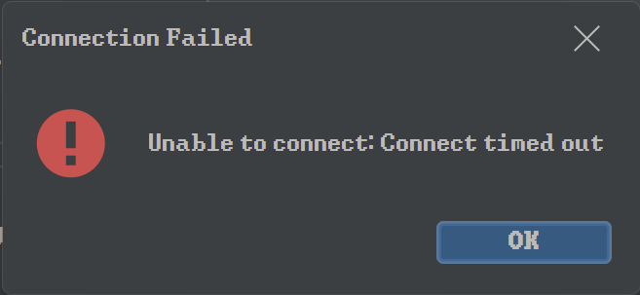
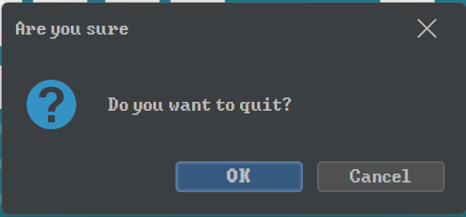
Consistent and modern user interface layout & logic
Various customization
Custom Form Styles
Custom cursor
Custom button rendering
Custom transparent background JPanel
Custom vertical display timer
Custom program font
Customizable interactive background
…
Notes:
Presenter: Stephen / Yuetian Chen

Slide 11

Stry233/RPI-Summer2022-AppJava-Draw-and-Guess-ver.RT (github.com)
!!!Demo!!!

